Slide 1


Distributing Collaborative Multi-Robot Planning with Gaussian Belief Propagation
Aalok Patwardhan, Riku Murai, Andrew J. Davison
IEEE Robotics and Automation Letters vol. 8, no. 2, pp. 552-559, Feb. 2023 doi: 10.1109/LRA.2022.3227858.

Slide 2
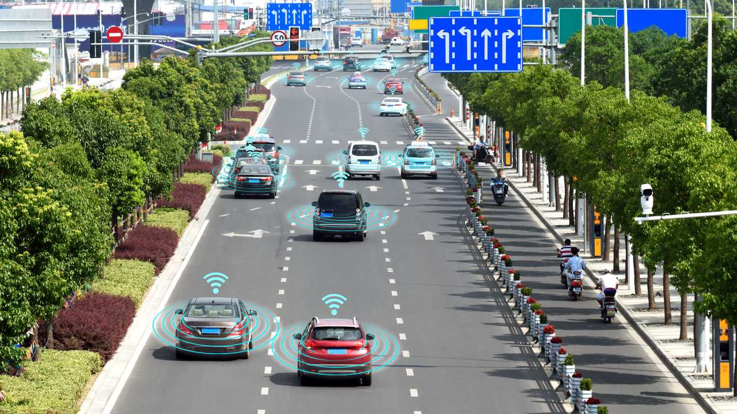



Autonomous collaboration is the future
… but centralised motion planning is not scalable
https://cdn.motor1.com/images/mgl/1MW0K/s3/autonomous-vehicles-on-road-communicationg-with-wifi-signals-and-radar.jpg

Slide 3
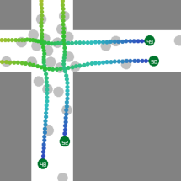
The GBP Planner (Gaussian Belief Propagation)
Robots can collaborate to plan safe and efficient paths with iterative message passing
Decentralised, via peer-to-peer communication
Asynchronous message passing brings robustness to communications failures
GBP Planner

Slide 4
Path Planning: the optimisation of
Variables
under
Constraints
Robot planned states (position and velocities)
(Nonlinear) cost functions
Horizon state
Dynamics
Obstacle avoidance
Current state
t=2
t=K
Towards goals
Inter-robot collision avoidance
t=1
t=0
Factor Graph Inference

Slide 5
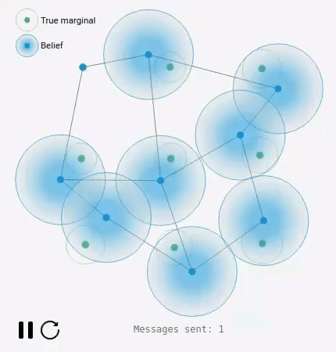
Background: Gaussian Belief Propagation (GBP)
Decentralised and iterative inference on a factor graph
Node-wise local message passing to update beliefs of variables
Global factor graph distributed between many robots
https://gaussianbp.github.io/

Slide 6
Obstacle factor
High cost if state is near obstacles in environment
Dynamics factor
High cost if robot path is dynamically infeasible
Horizon state
Robot A
t=2
t=K
t=1
Current state
t=0
Towards goals
Inter-robot factor
High cost if robot states overlap at same timestep
t=K
Horizon state
t=2
t=1
t=0
Robot B
Current state

Slide 7
Obstacle factor
High cost if state is near obstacles in environment
Dynamics factor
High cost if robot path is dynamically infeasible
Horizon state
Robot A
t=2
t=K
t=1
Current state
t=0
Towards goals
Inter-robot factor
High cost if robot states overlap at same timestep
t=K
Horizon state
t=2
t=1
t=0
Robot B
Current state

Slide 8
Obstacle factor
High cost if state is near obstacles in environment
Dynamics factor
High cost if robot path is dynamically infeasible
Horizon state
Robot A
t=2
t=K
t=1
Current state
t=0
Towards goals
Inter-robot factor
High cost if robot states overlap at same timestep
t=K
Horizon state
t=2
t=1
t=0
Robot B
Current state

Slide 9
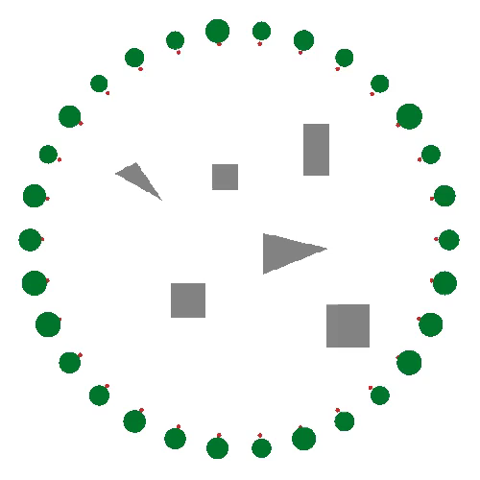
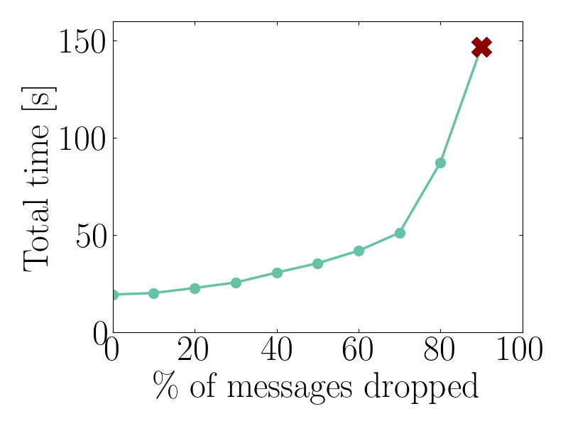
Circle Crossing Experiment
Robots of various sizes must avoid obstacles and each other
Better performance and scalability than ORCA¹, a popular distributed reactive planner
Communications failure:
Collision-free paths even when a high proportion of messages are dropped
[1] J. van den Berg, S. Guy, M. Lin, and D. Manocha. Reciprocal N-body collision avoidance. Proceedings of the International Symposium on Robotics Research (ISRR), 2009

Slide 10

Warehouse Junction Experiment
Robots travel at high speeds through a junction
Collaboration in GBP planner allows high flowrate to be maintained
Blockages caused by reactive planner
Target speed: 100 km/h
100m

Slide 11

The GBP Planner
Robots can collaborate to plan safe and efficient paths with iterative message passing
Decentralised, therefore scalable to large numbers of robots
Wide reaching benefits for self-driving cars, teams of robots working together
100m

Slide 12
Distributing Collaborative Multi-Robot Planning with Gaussian Belief Propagation
Aalok Patwardhan, Riku Murai, Andrew J. Davison
IEEE Robotics and Automation Letters vol. 8, no. 2, pp. 552-559, Feb. 2023 doi: 10.1109/LRA.2022.3227858.

Slide 13
Section title to go here

Slide 14
Section title to go here

Slide 15
Title
Point 1
Point 2

Slide 16
“For quotes” or call out text

Slide 17
“For quotes” or call out text

Slide 18





Logo Variations

